Slide 1

Tooth development
RUNGTA COLLEGE OF DENTAL SCIENCES & RESEARCH
DEPARTMENT OF ORAL PATHOLOGY

Slide 2
OBJECTIVES
To know the various morphologic and physiologic stages of tooth development and their application in clinical aspects relating to pathologies

Slide 3
Specific learning Objectives
Core areas* | Domain ** | Category #
Stages of Tooth Development | COGNITIVE | MUST KNOW
Morphologic stage Dental Lamina Bud stage Cap stage Bell stage HERS Histophysiologic stages Function of enamel knot Growth factors | COGNITIVE COGNITIVE COGNITIVE COGNITIVE COGNITIVE COGNITIVE COGNITIVE COGNITIVE | MUST KNOW MUST KNOW MUST KNOW MUST KNOW MUST KNOW MUST KNOW NICE TO KNOW DESIRED TO KNOW

Slide 4
Contents
Stages of TOOTH DEVELOPMENT
Morphologic stages of tooth development
Development of root
Histophysiologic stages of tooth development
OVERLAPPING of tooth development stages

Slide 5
Tooth development

Slide 6
Stages of TOOTH DEVELOPMENT
2 stages :
Morphologic
Histophysiologic
Morphology : - Shape or Form of tooth germ
Histophysiology : - Differentiation & Function of cells

Slide 7
Morphologic stages of tooth development
5 stages :
Development of dental lamina
Bud stage
Cap stage
Bell stage ( Early & Advanced)
Development of root (HERS development)

Slide 8
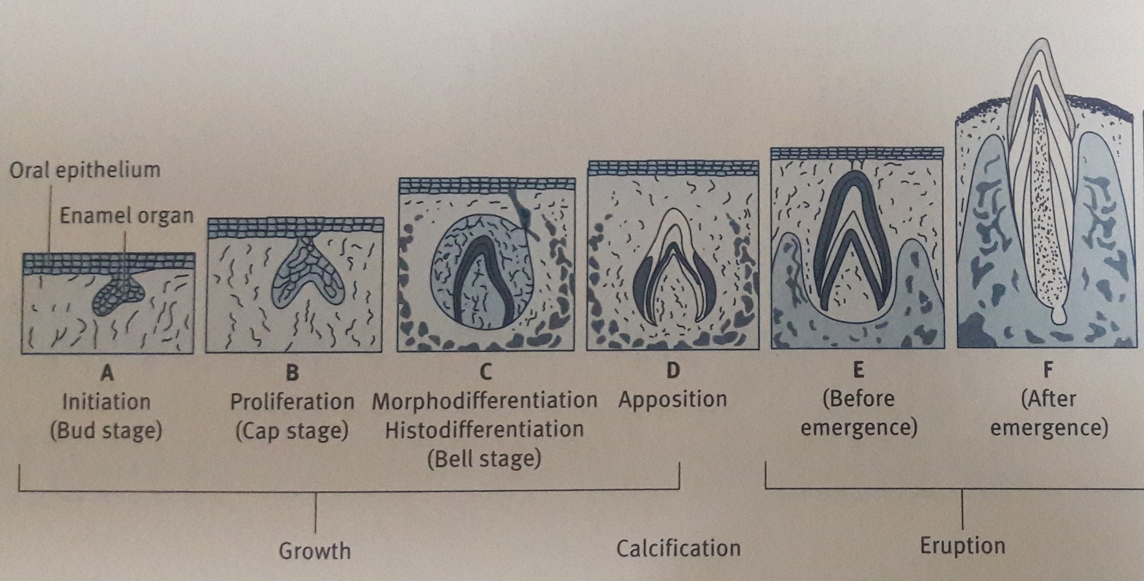

Slide 9
Histophysiologic stages of tooth development
5 stages :
Initiation
Proliferation
Histodifferentiation
Morphodifferentiation
Apposition

Slide 11
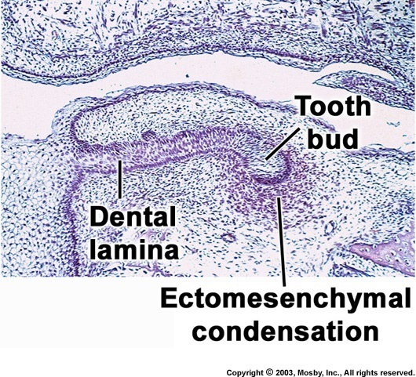
DENTAL LAMINA
Round/ovoid , series of epithelial knob like outgrowths at future teeth-site
Grows into ectomesenchymal condensation
Serves as Enamel organ primordia – forms tooth bud / teeth
10 in maxilla
10 in mandible

Slide 12
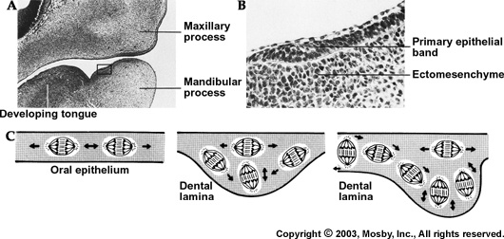
DENTAL LAMINA
Knob like thickening

Slide 13
Bud Stage
6 highlighting points
Morphological shape = Bud of flower
Derived from Oral ectoderm - epithelium from the 1st branchial arch -initiation of tooth
Periphery - low columnar cells
Centrally polygonal cells – high RNA content
Cells undergo mitosis
Area of ectomesenchymal condensation - Dental papilla & dental sac (are less defined)

Slide 14
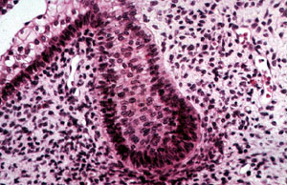
Dental sac
(Dental Follicle)
Dental Papilla

Slide 15
Cap Stage
7 highlighting points
Morphological shape = Cap (due to invagination on deep surface of bud)
Outer enamel epithelium
Inner enamel epithelium
Stellate reticulum
Dental papilla
Dental sac (dental follicle)
Transitory structures ( enamel knot, enamel cord, enamel niche, enamel septum, enamel navel )

Slide 16
Bud stage
Tooth bud continues to proliferate
Uneven growth in different part of bud leads to cap stage
Characterized by invagination on deep surface of bud

Slide 17
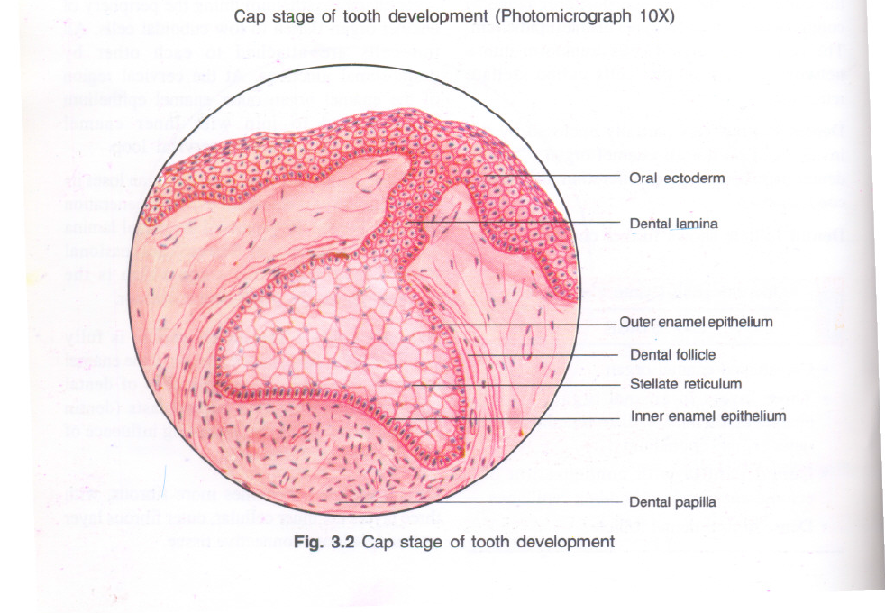

Slide 18
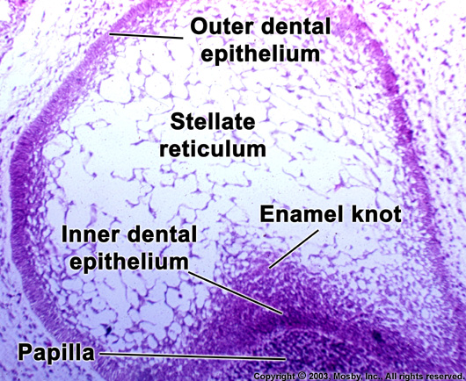
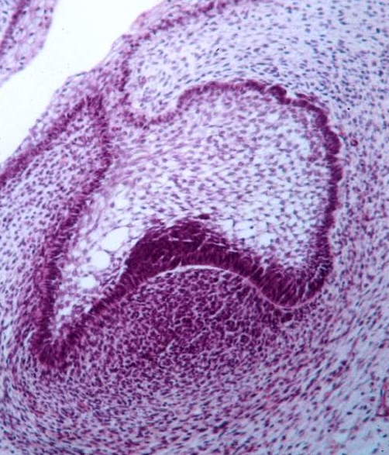
STELLATE
RETICULUM
star shaped

Slide 19
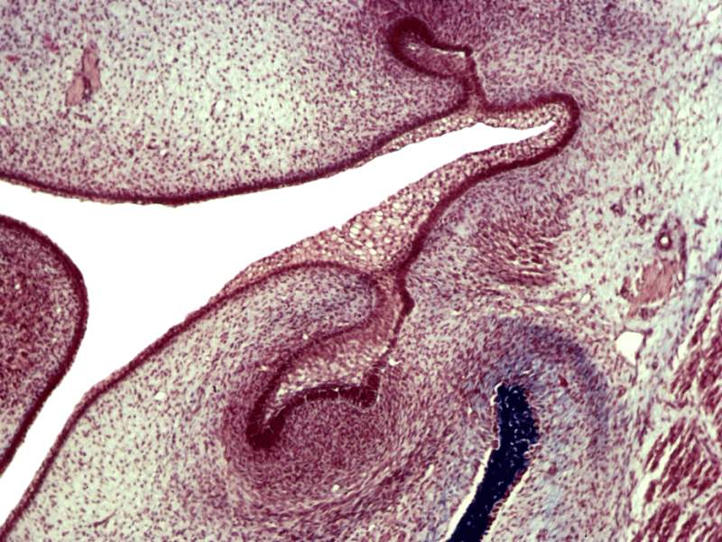
Cap Stage
Dental Lamina
Dental Follicle/Sac
Dental papilla

Slide 20
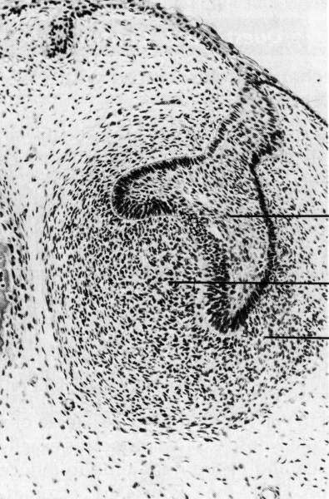
Cap Stage of Tooth Development
Dental (enamel) organ
Dental papilla
Dental follicle
©Copyright 2007, Thomas G. Hollinger, Gainesville, Fl

Slide 21
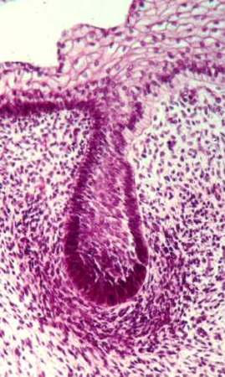
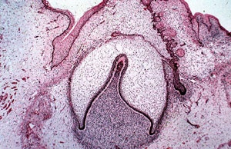
Bell stage
? Bell - Morphological shape = Bell
Divided into – Early bell stage & Advanced bell stage
BUD
CAP
BELL

Slide 22
Structures Seen In Bell Stage
Early Bell stage
Outer enamel epithelium
Inner enamel epithelium – (Ameloblast)
Stellate reticulum
Stratum intermedium
Dental papilla – (Odontoblast)
Dental sac/dental follicle
Advanced Bell stage
Structures of early +
Dentin
Enamel
Successional dental lamina
Cervical loop (HERS)

Slide 23
3. Bell Stage
Successional
Dental lamina
Outer dental
epithelium
Inner dental
epithelium
Dental papilla
Dental follicle
Cervical loop
Continued growth leads to bell stage, where the enamel organ resembles a bell with deepening of the epithelium over the dental papilla

Slide 24
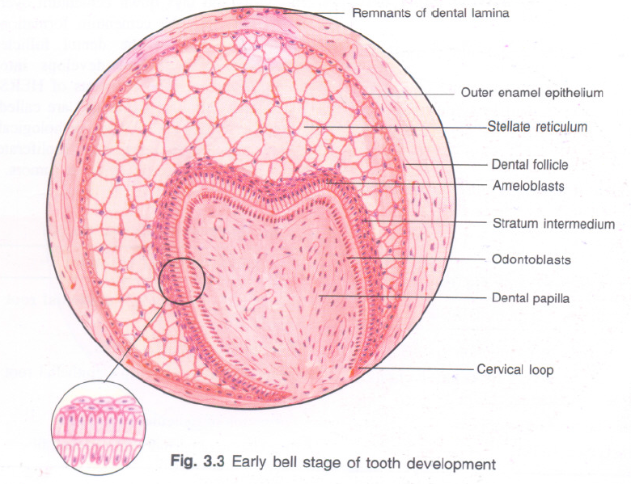

Slide 25
Advanced bell stage
Commencement of mineralization
First cell to differentiate – ameloblast
Ameloblast cause differntiation of odontoblast (from DP)
Odontoblast – lay down dentin along cusp tips
(So Dentin is 1st formed hard tissue of the tooth )

Slide 26
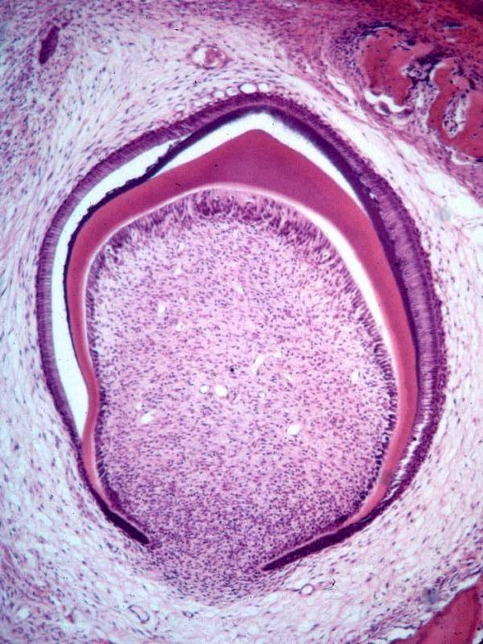
Ameloblastblast
Enamel
Dentin
Odontoblast
Dental papilla
(Dentin + pulp)
Cervical loop/HERS
Dental Follicle / Sac
(Cementum + pdl + bone)

Slide 27
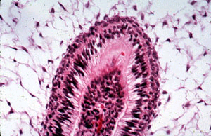
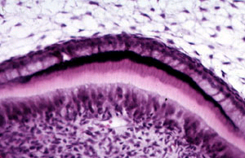
Dentin
Odontoblasts
Ameloblasts
First layer of enamel
Dentin
Odontoblasts

Slide 28
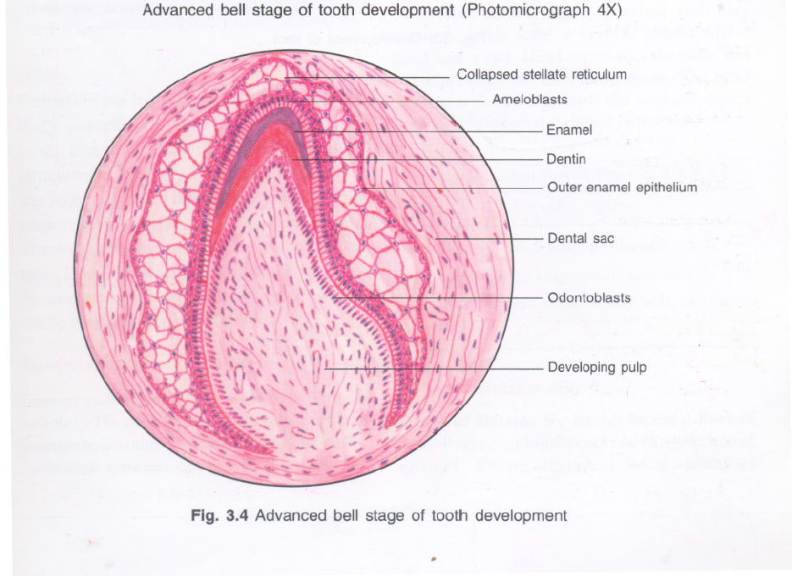

Slide 29
Root formation - HERS
Starts when Enamel & Dentin formation reaches future CEJ (cemento-enamel junction)
HERS = IEE + OEE
Area also called as
cervical loop

Slide 31
HERS
It is a proliferation of epithelial cells (IEE + OEE) located at the cervical loop of enamel organ in a developing tooth root
Helps in differentiation of odontoblast from dental papilla at root level (radicular dentinogenesis)
It is involved in cementogenesis (formation of cementum)

Slide 32
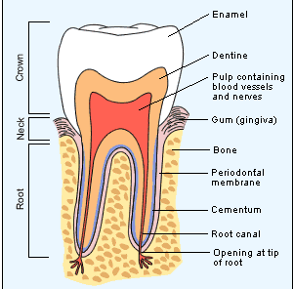
coronal
dentin
CEJ
radicular
dentin

Slide 33
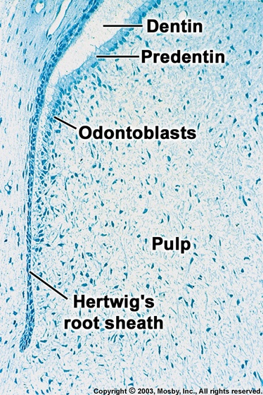

Slide 34
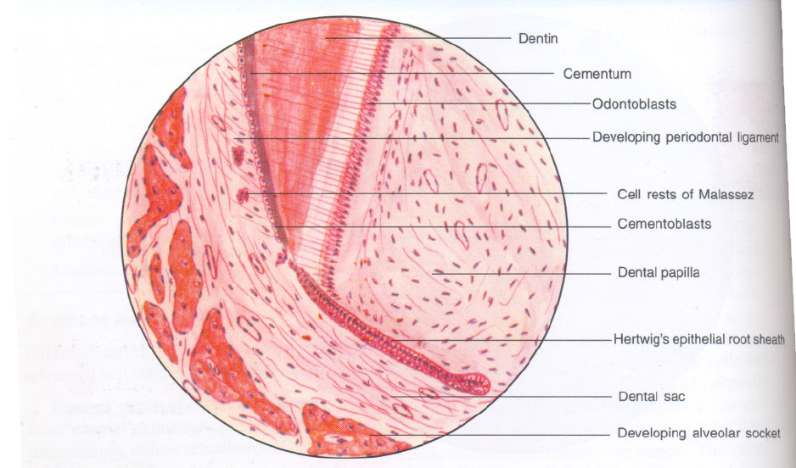

Slide 35
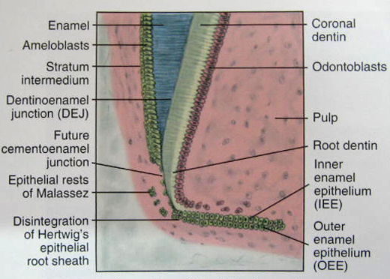
CELL REST OF MALASSEZ
After root formation HERS disintegrates
Remnants of HERS are known as cell rest of malassez
Seen in PDL

Slide 36
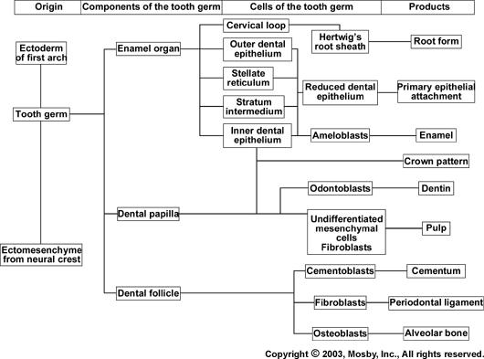

Slide 37
Histophysiologic (or) Physiologic stages of tooth development
Initiation
Proliferation
Histodifferentiation
Morphodiffeentiation
Apposition

Slide 38
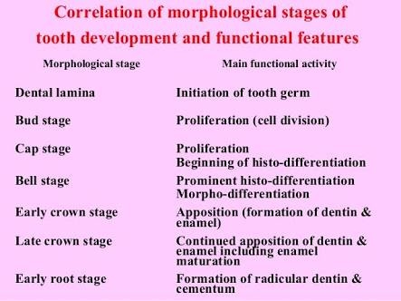

Slide 39
SUMMARY
Tooth development or odontogenesis is the complex process by which teeth form from embryonic cells, grow, and erupt into the mouth.
For human teeth to have healthy oral environment , all parts of the tooth must develop during appropriate stages of fetal development.
Primary (baby) teeth start to form between the sixth and eighth week of prenatal development, and permanent teeth begin to form in the twentieth week.
Lecture focused on tooth development, starting with the bud stage. A description of the formation of the tooth continued through the section on the cap stage and the bell stage, and finally, the maturation stage was described.

Slide 40
Take Home Message
Tooth development occurs in 5 different stages-
Development of dental lamina
Bud stage
Cap stage
Bell stage ( Early & Advanced)
Development of root (HERS development)

Slide 41
References
SN Bhaskar . Orban’s ,Oral Histology and embryology. 11th edition, Mosby 1998
Neville BW ,Damm DD ,Allen CM ,Bouquot JE . Oral and maxillofacial pathology , 2nd Edition .Philadelphia W.B. Saunders ;2002
Richard Tencate , Oral Histology development ,structure and function . 5th Edition ,1998
Carranza F.A., Michael G. Newman . Clinical periodontology 8,9,10th edition

Slide 42
Frequentely Asked Questions
Describe morphologic stages of tooth development. Write in detail about bud/cap/bell stage
Dental lamina
Hertwig epithelial root sheath (HERS) / Development of root
Transient structures in cap stage
Histophysiologic stages of tooth development & their overlapping with morphologic stages

Slide 43
THANKYOU

